Slide 1

ORIENT AI: Intelligent Guidance
An AI-Driven Application for Predicting Academic Fit and Career Satisfaction
Tutors: Joanna Jojczyk & Zdzisława Rowińska Department of Computer Science & ML Sub-Teams
Notes:
P1

Slide 2
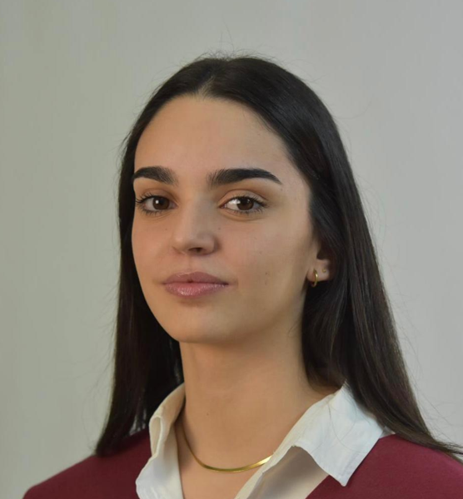
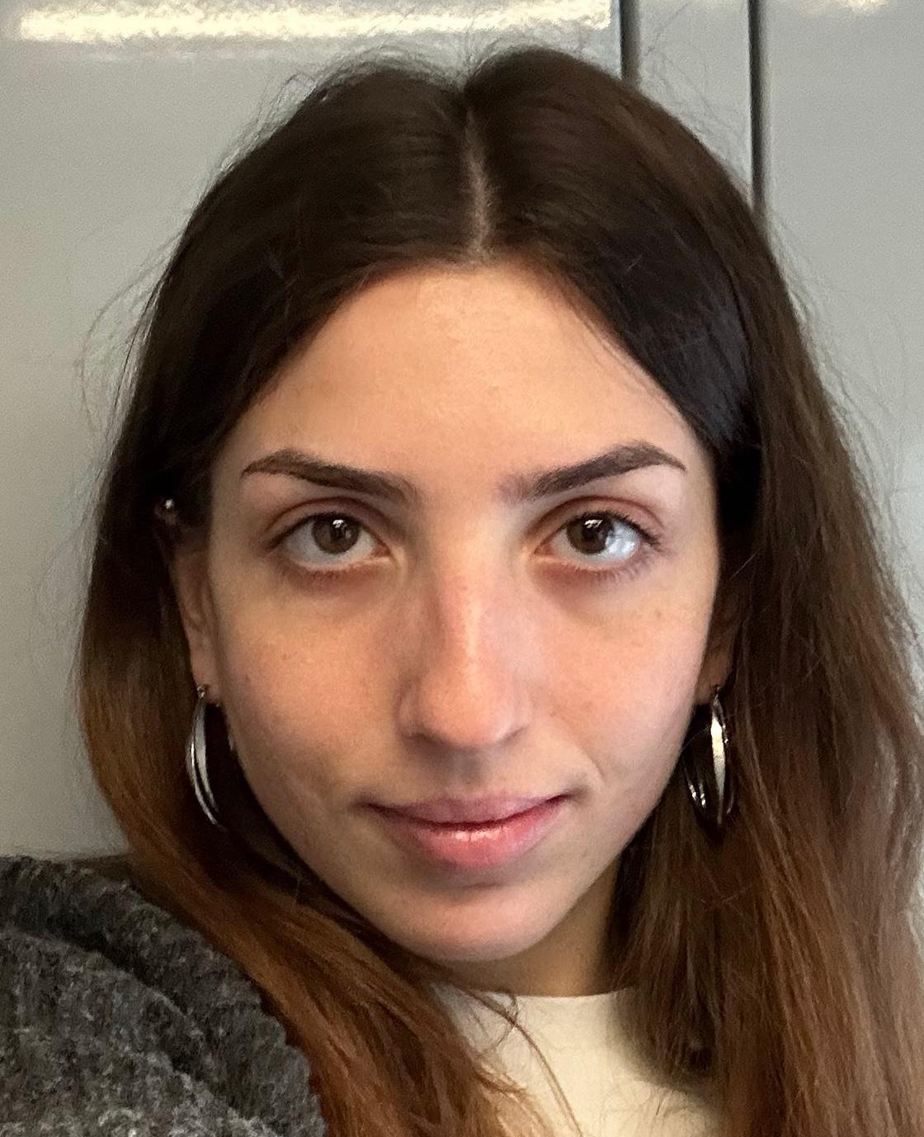










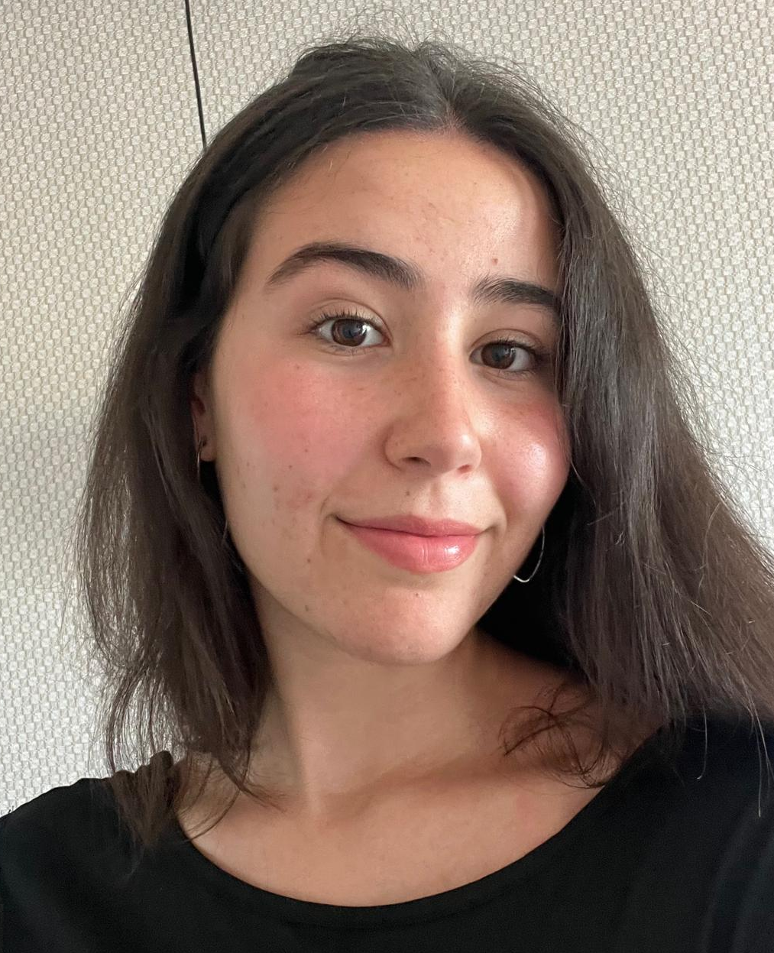
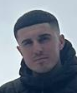





Meet the Team
A multidisciplinary engineering group split into software development and machine learning sub-teams to build Orient AI.
Aroa Aguiño Domínguez
María Encina Díez del Río
Jorge Domínguez Palomo
Jaime Esteban Reano
Mario Fernández Costello
Naroa Genicio Iglesias
David Sánchez Sánchez
Notes:
P1
hablar de q team es cada y poner orden segun hablamos

Slide 3

The Vocational Crisis
Traditional systems are failing. Students face structural disorientation and friction in their careers.
Obsolete and static instruments
Blind elimination strategy
Severe personal impact (dropout)
Notes:
P1
Traditional guidance systems rely on archaic, static, and generalized tests. Students face structural disorientation, leading to high friction in their career paths.
Outdated, Static Instruments: Existing counseling tools are simple rule-based templates that fail to capture modern multi-dimensional interests.
"The Elimination Strategy": Students blindly discard hated subjects or yield to external societal or parental expectations.
Severe personalImpact: High drop-out rates, acute personal frustration, and resource-intensive academic abandonment.

Slide 4

State of the Art: 2025–2026
Pymetrics (Neuroscience-Based)
Method: Uses neuroscience games and AI to assess cognitive and emotional traits.
Goal: Matches users with roles where similar profiles have succeeded.
Kickresume (AI Career Coach)
Method: Analyzes resumes using LLMs (Large Language Models).
Goal: Identifies skill gaps and suggests career paths for professional transitions.
AICareerCoach.org (Conversational Mentor)
Method: A free, chatbot-style tool by CareerVillage.
Goal: Acts as a mentor for students to explore interests through dialogue.
Steppingblocks (Big Data Insights)
Method: Educational data analytics using "Big Data."
Goal: Shows real-world career paths based on the outcomes of millions of professionals.
IBM Watson Career Coach (Corporate NLP)
Method: Utilizes Natural Language Processing (NLP).
Goal: Helps employees find internal growth opportunities aligned with their skills.
‹#›
1
Notes:
P1
So, as we mentioned, there is a clear demand for a new type of solution, so we looked at what already exists in the market. There are several interesting approaches using AI in career guidance.
For example, some platforms like Pymetrics use neuroscience-based games to assess cognitive and emotional traits. Others, like AI career coaches, use conversational AI to guide users. We also see solutions based on big data, which analyze the career paths of millions of professionals to suggest possible futures. So overall, these tools are clearly moving in the right direction, they use AI, personalization, and data.
However, despite these advances, they still don’t fully solve the problem we identified.

Slide 5


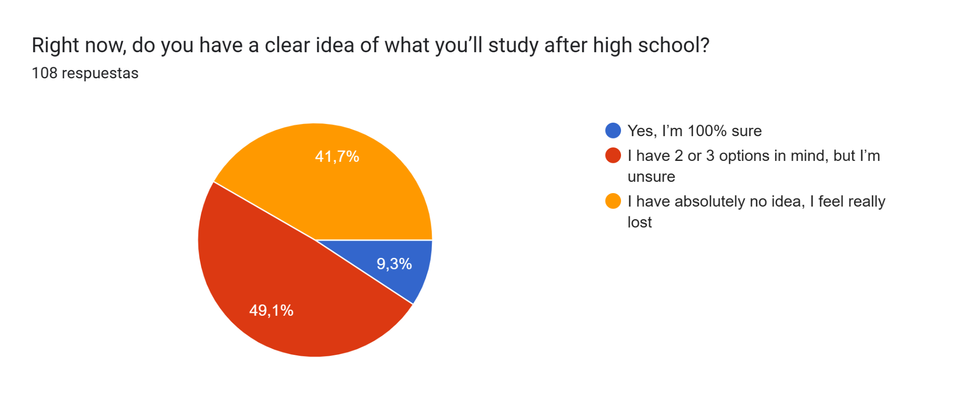
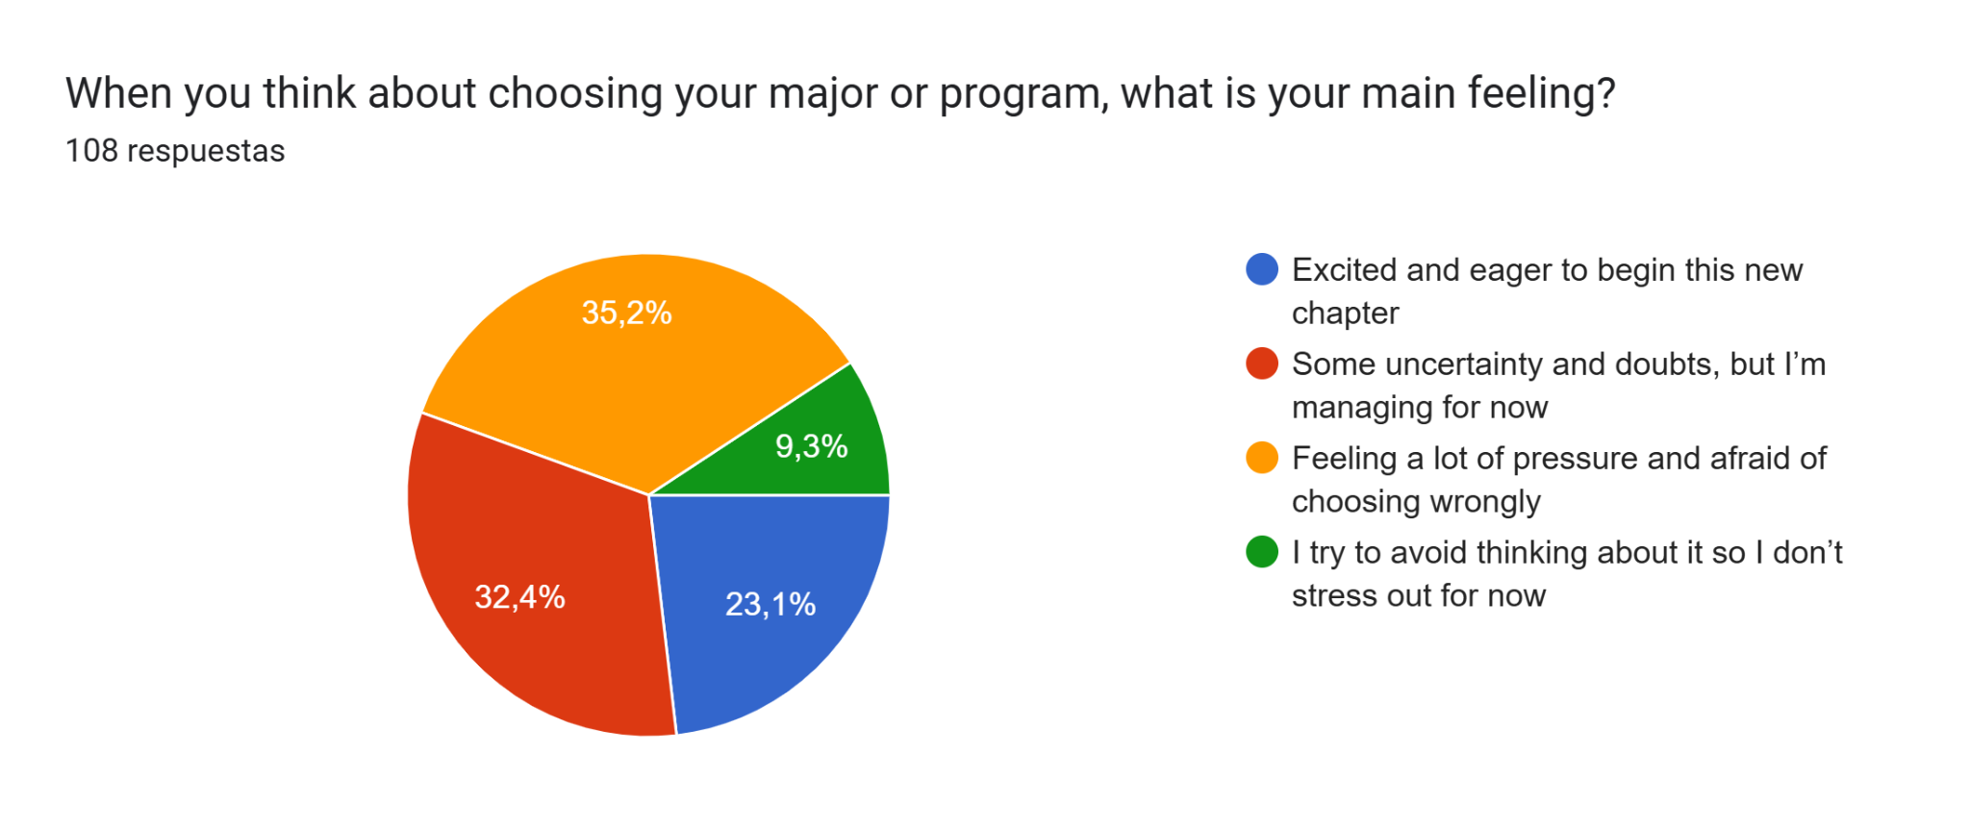
Empirical Field Validation
Qualitative Validation
Quantitative Survey
Notes:
P1
as presented on the mid presentation- We conducted exhaustive research at Lodz University of Technology to confirm the theoretical crisis through real student experiences.
Qualitative validation: Conducted deep group interviews with active university students. Results showed a severe information gap: students were completely overwhelmed by academic offerings and lacked clear ways to translate high school traits into specific engineering degrees.
Quantitative survey: Deployed a structured Google Forms survey across Lodz. Gathered 238 initial student datasets containing 25 Likert-scale questions on task preferences, current fields, and a self-reported 0–100 career satisfaction score.

Slide 6
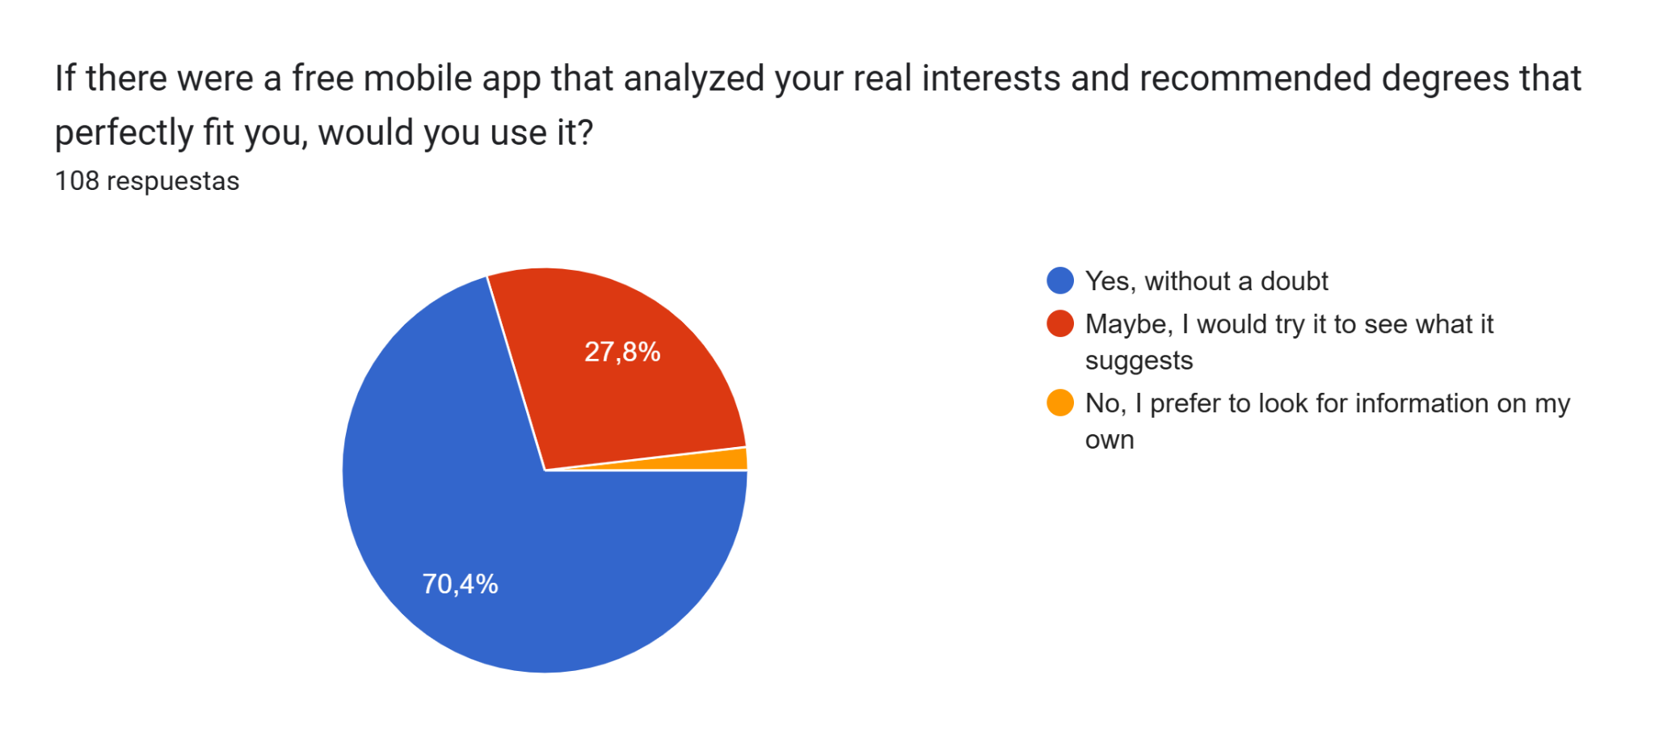
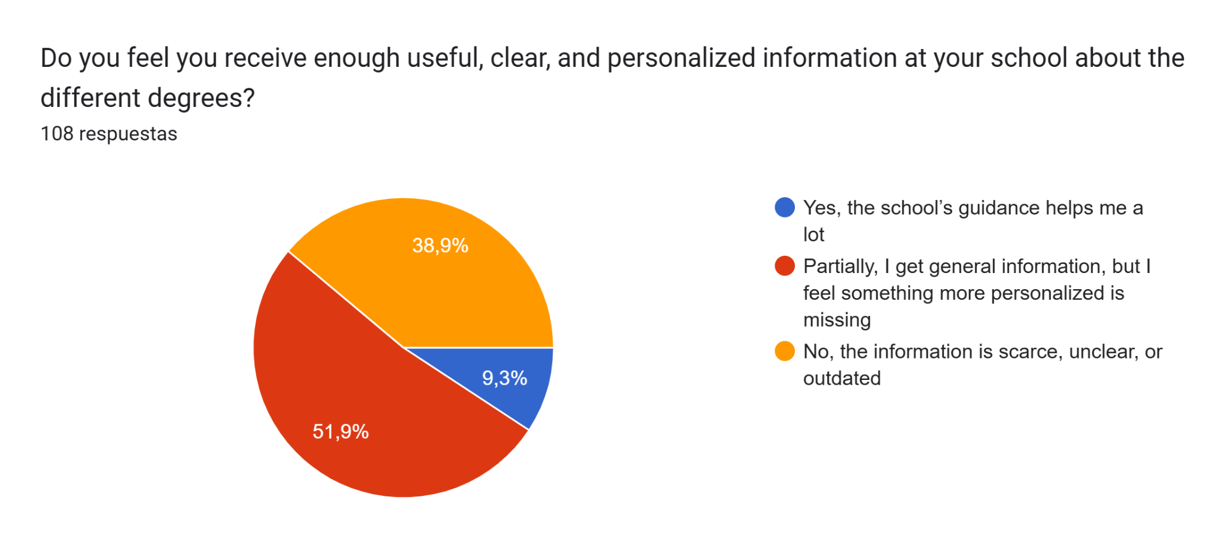
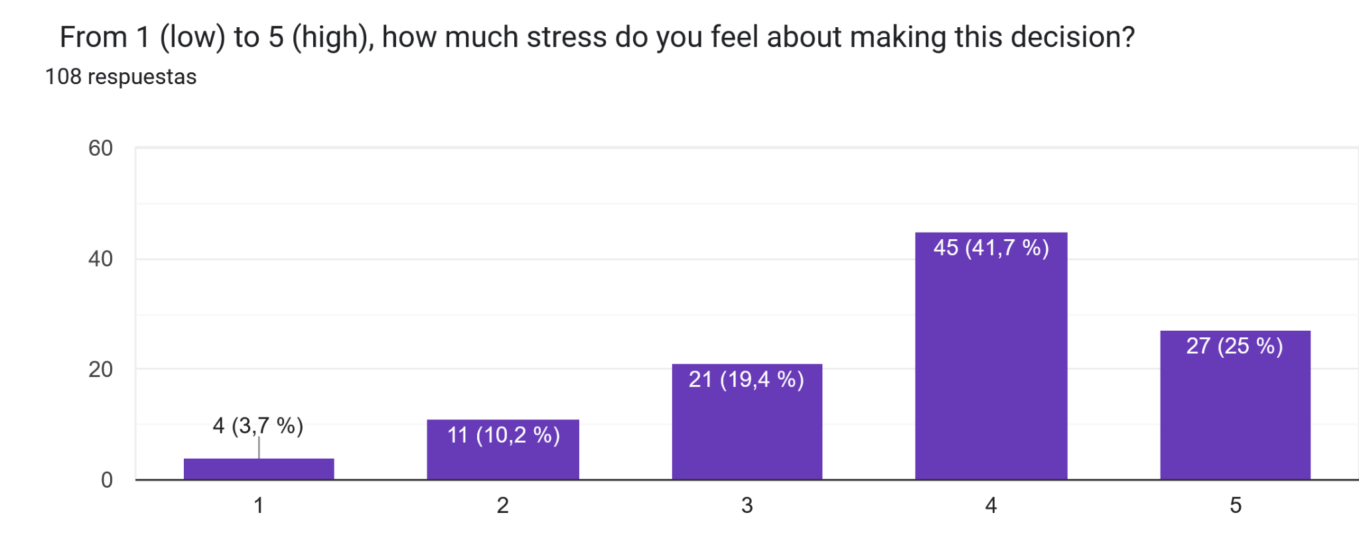
Empirical Field Validation
Qualitative Validation
Quantitative Survey
Notes:
P1
as presented on the mid presentation- We conducted exhaustive research at Lodz University of Technology to confirm the theoretical crisis through real student experiences.
Qualitative validation: Conducted deep group interviews with active university students. Results showed a severe information gap: students were completely overwhelmed by academic offerings and lacked clear ways to translate high school traits into specific engineering degrees.
Quantitative survey: Deployed a structured Google Forms survey across Lodz. Gathered 238 initial student datasets containing 25 Likert-scale questions on task preferences, current fields, and a self-reported 0–100 career satisfaction score.

Slide 7






OUR SOLUTION: ORIENT AI
Our intelligent framework goes beyond standard classification. By modeling psychological profiles, it bridges the gap between student aspirations and academic realities.
1. Predict "Where"
2. Predict "How Much"
3. Predict "What"
‹#›
Notes:
P1
need of an ai model that not only guides into the area of study but also helps predict satisfcation
Instead of relying on single categorical labels, our intelligent model maps student profiles dynamically onto multiple dimensions.
The "Where" & "How Much" Concept:
Our system predicts both the most compatible overarching academic area (Stage 1) and a continuous expected satisfaction score from 0% to 100% (Stage 2) to proactively mitigate university dropout risk. Predict “Where”: ptitude Mapping: Identifies the most compatible Field of Study based on behavioral indicators.
Predict “How Much”: Fulfillment Score: Forecasts a Satisfaction Score (0-100) to mitigate dropout risk.
Predict “What”: Concrete Roadmap: Routes technical profiles to specific faculties at Lodz University of Technology.

Slide 8




THE STAKEHOLDERS: WHO WE’RE BUILDING FOR
Primary: Students
Secondary: Counselors & Parents
Tertiary: Universities & Employers
‹#›
13
Notes:
P2
Lo que digo: To understand our impact, we must look at who we are building for.
Our Primary users are students who are facing 'choice paralysis' and need personalized, data-backed guidance.
Secondary stakeholders include parents and counselors, who need objective metrics to support student wellbeing and remove the guesswork from the process.
Finally, we provide massive value to Universities and Employers. By ensuring a genuine 'Person-Environment Fit,' we help them drastically reduce dropout rates and hire professionals who are actually aligned with their roles."
Our solution targets three main groups: First, students, who need personalized guidance. Second, counselors and parents, who want objective data. And third, universities and employers, who want better alignment and lower dropout rates.
Pre-university or university students with doubts seeking data-validated, personalized career recommendations.
School counselors and families seeking objective data to reduce uncertainty and support student wellbeing.
Institutions seeking to reduce dropout rates and hire professionals with genuine Person-Environment Fit.

Slide 9
Collaborative Team Architecture
To execute the project, the team divided into two specialized sub-teams with distinct technical briefs, unified through a chained JSON pipeline handoff.
terminal
Software Development Team
Jorge Domínguez Palomo
Jaime Esteban Reano
David Sánchez Sánchez
Streamlit / Python
UX/UI Custom CSS
Notes:
P2
AÑADIR FOTOS DDE CADA UNO
Software Development Team: Engineered the client-facing architecture. Built the pure-Python Streamlit web interface with a dark-navy design system. Implemented Google Fonts styling (Syne & DM Sans), real-time progress indicators, custom reactive star-rating selectors, and a zero-loss JSON output handoff module to save user features silently.
Machine LearningSub-team: Executed extensive data engineering on 145,000 baseline OpenPsychometrics records. Developed standard normalization scripts, executed dimensionality reduction, applied statistical ranking metrics, trained multi-model classification/regression networks, and exported production-ready serialization wrappers.

Slide 10
Collaborative Team Architecture
To execute the project, the team divided into two specialized sub-teams with distinct technical briefs, unified through a chained JSON pipeline handoff.
Machine Learning Team
Aroa Aguiño Domínguez
María Encina Díez del Río
Mario Fernández Costello
Naroa Genicio Iglesias
Orange Data Mining
Scikit-Learn / ML
Notes:
P2
AÑADIR FOTOS DDE CADA UNO
Software Development Team: Engineered the client-facing architecture. Built the pure-Python Streamlit web interface with a dark-navy design system. Implemented Google Fonts styling (Syne & DM Sans), real-time progress indicators, custom reactive star-rating selectors, and a zero-loss JSON output handoff module to save user features silently.
Machine LearningSub-team: Executed extensive data engineering on 145,000 baseline OpenPsychometrics records. Developed standard normalization scripts, executed dimensionality reduction, applied statistical ranking metrics, trained multi-model classification/regression networks, and exported production-ready serialization wrappers.

Slide 11

SOFTWARE DEVELOPMENT

Slide 12
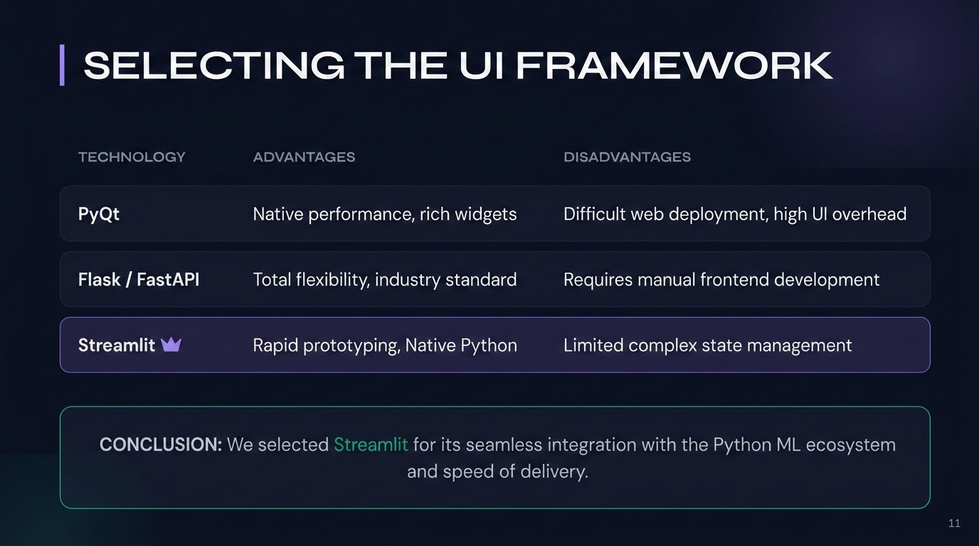
‹#›

Slide 13
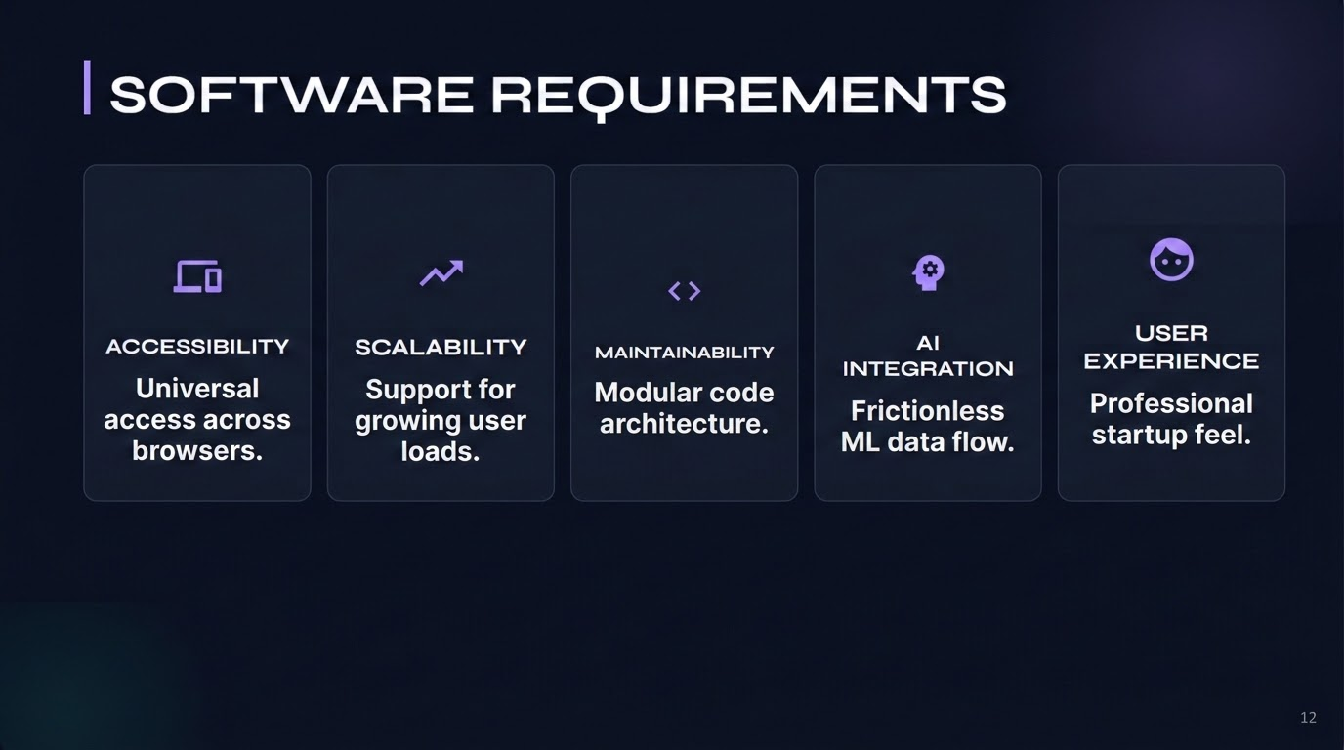
‹#›

Slide 14
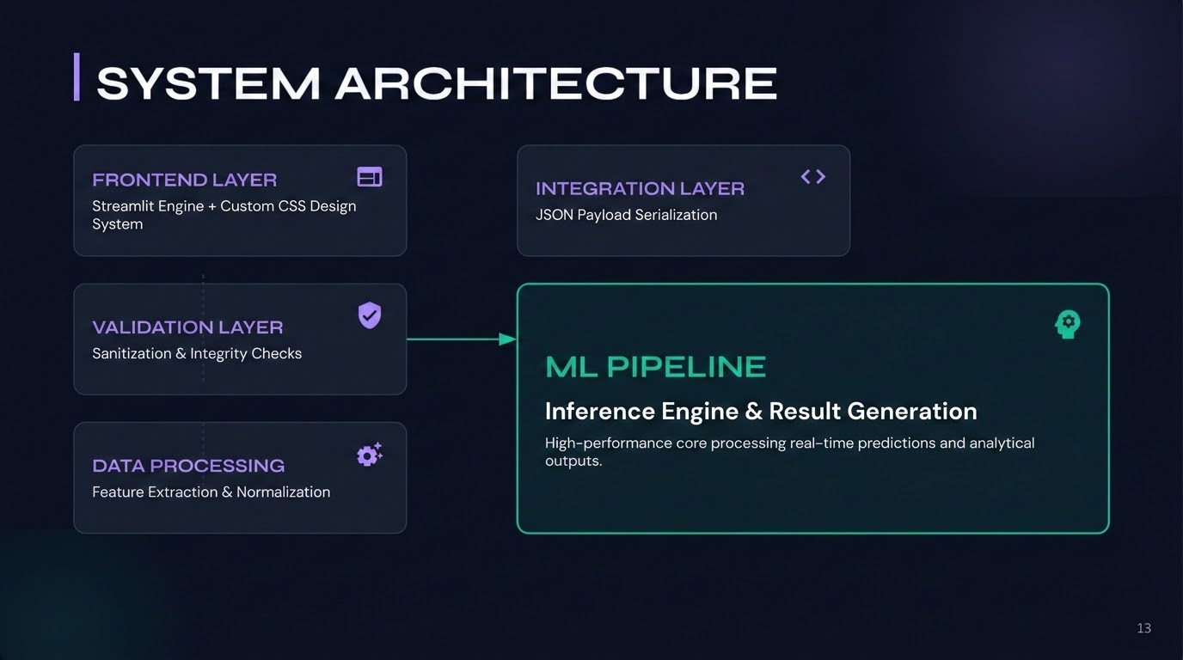
‹#›

Slide 15
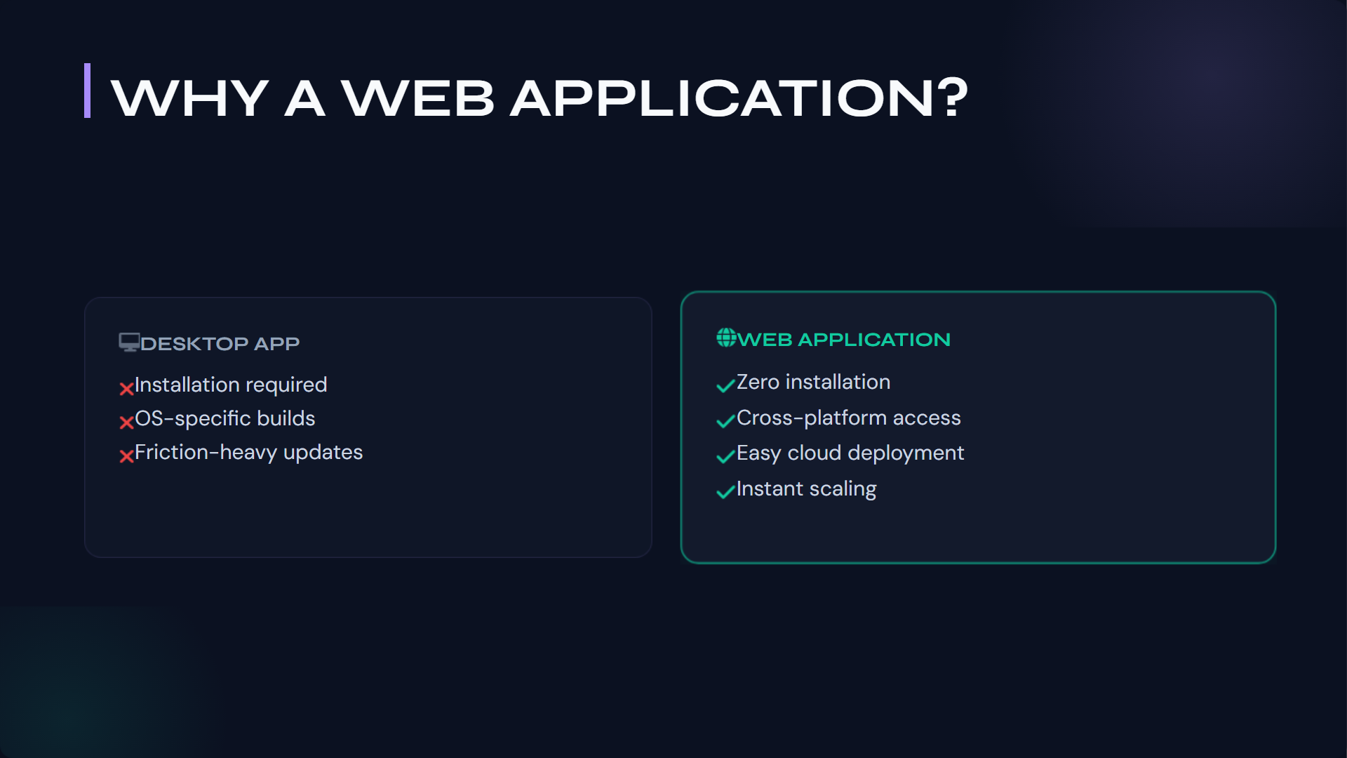
Notes:
"You might wonder why we pushed for a web-first approach rather than a mobile app or desktop software. The answer comes down to reducing user friction. Desktop applications require downloads, installations, and operating system compatibility checks—all barriers for a high school student looking for quick guidance. By building Orient AI as a web application, we achieved zero installation friction. Students can access it instantly from any browser, whether on a school Chromebook or their personal smartphone. Furthermore, from an engineering standpoint, web deployment allows us to push updates, fix bugs, and deploy new machine learning models instantly to all users without requiring them to download patches."

Slide 16
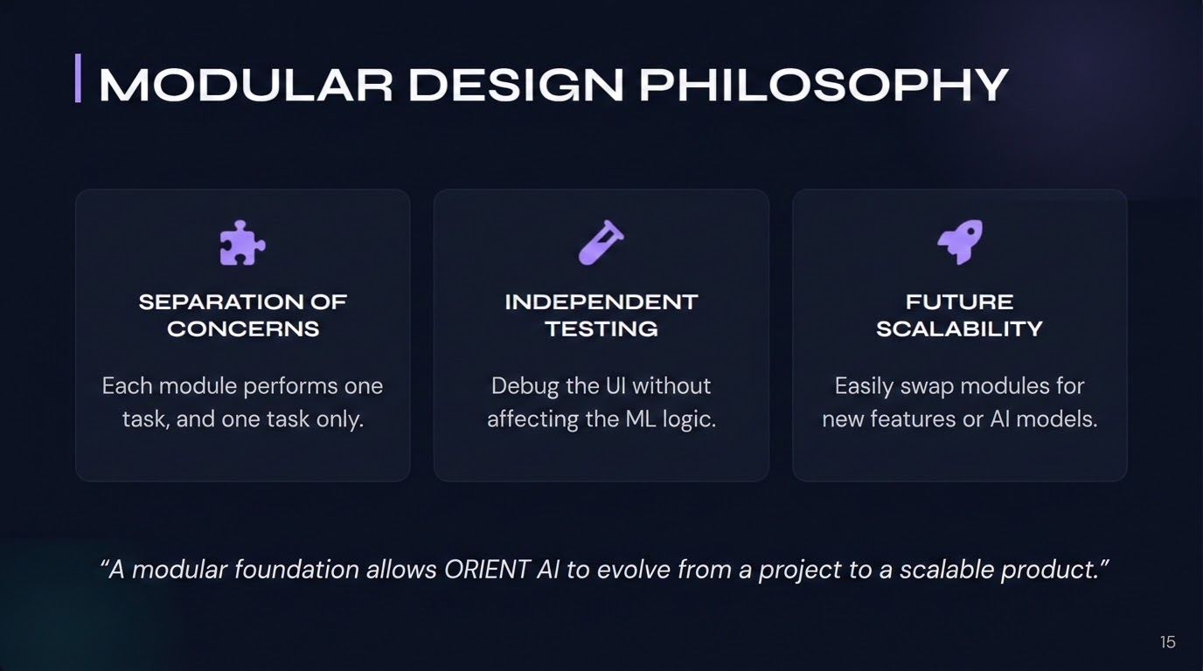
‹#›

Slide 17
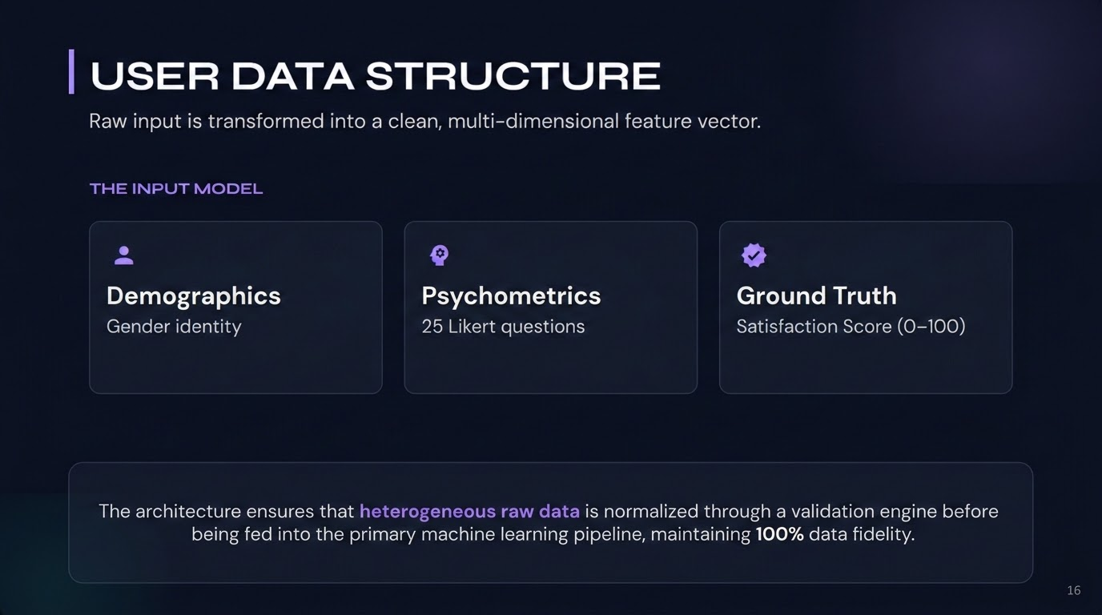
‹#›

Slide 18
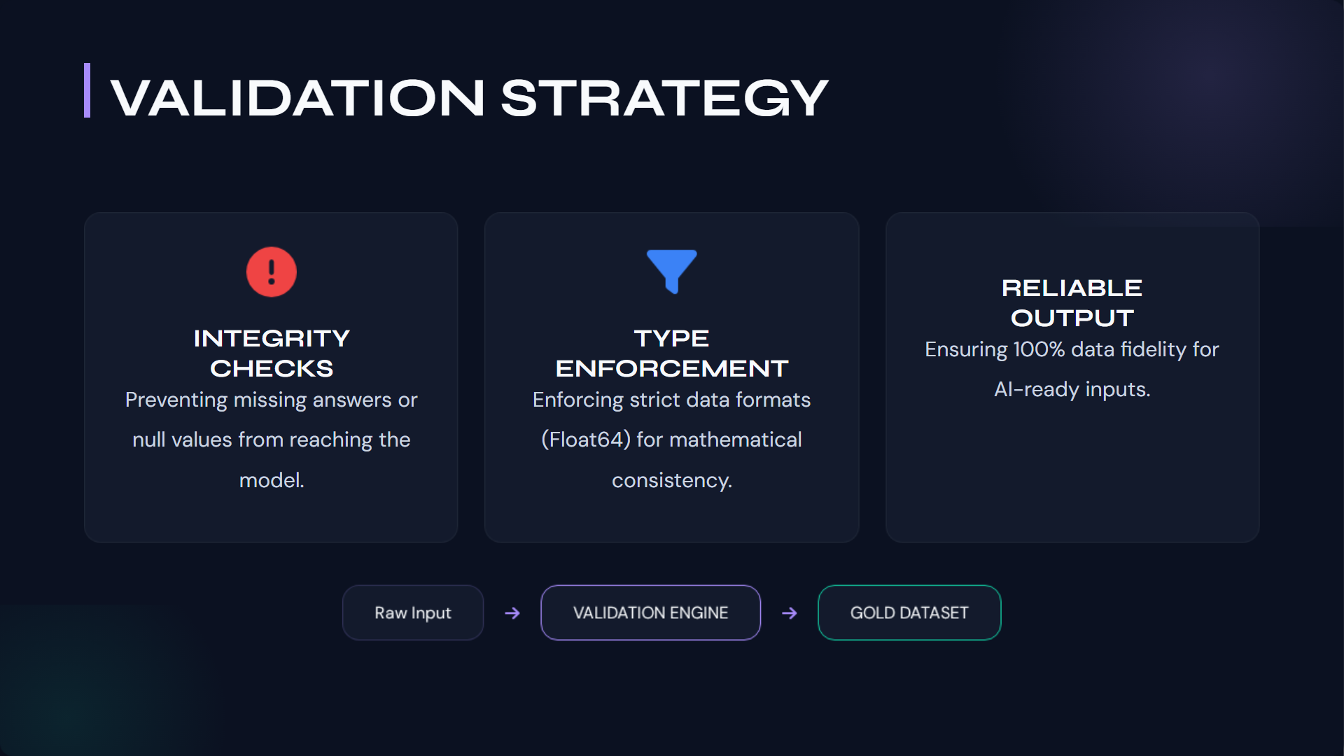
‹#›
Notes:
"Machine learning models are incredibly powerful, but they share one universal weakness: 'garbage in, garbage out.' To protect our predictive engine, the software team implemented a rigorous Validation Strategy. Our validation layer actively monitors user input in real-time. It catches missing answers, blocks invalid or out-of-bounds values, and tracks the session state to prevent incomplete submissions from triggering an API call. Finally, it enforces strict data consistency, ensuring that strings are strings and integers are integers. By building this digital firewall, we guarantee that the Machine Learning models only ever compute clean, 100% reliable data."

Slide 19
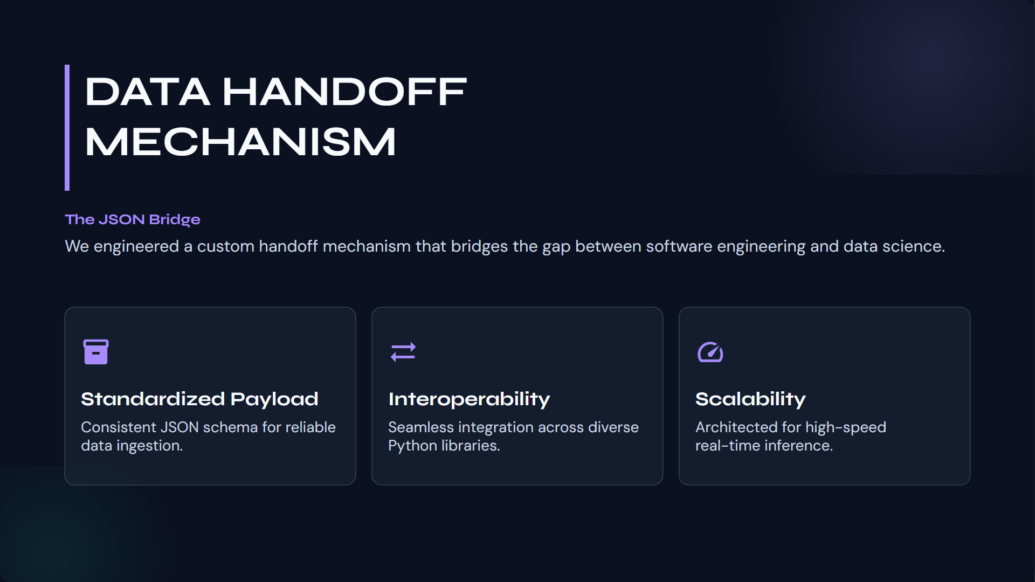
Notes:
"Once the data is collected and validated, it must be handed over to the AI. We built a custom JSON handoff logic for Stage 1 and Stage 2 fusion. Why JSON? Because it acts as the perfect universal translator. The frontend packages the exact features extracted from the questionnaire into a lightweight JSON payload. This standardized structure guarantees interoperability between our web framework and our machine learning scripts. It is incredibly fast, highly secure, and scales effortlessly. This JSON bridge is the exact point where our software engineering successfully hands the baton over to data science."

Slide 20
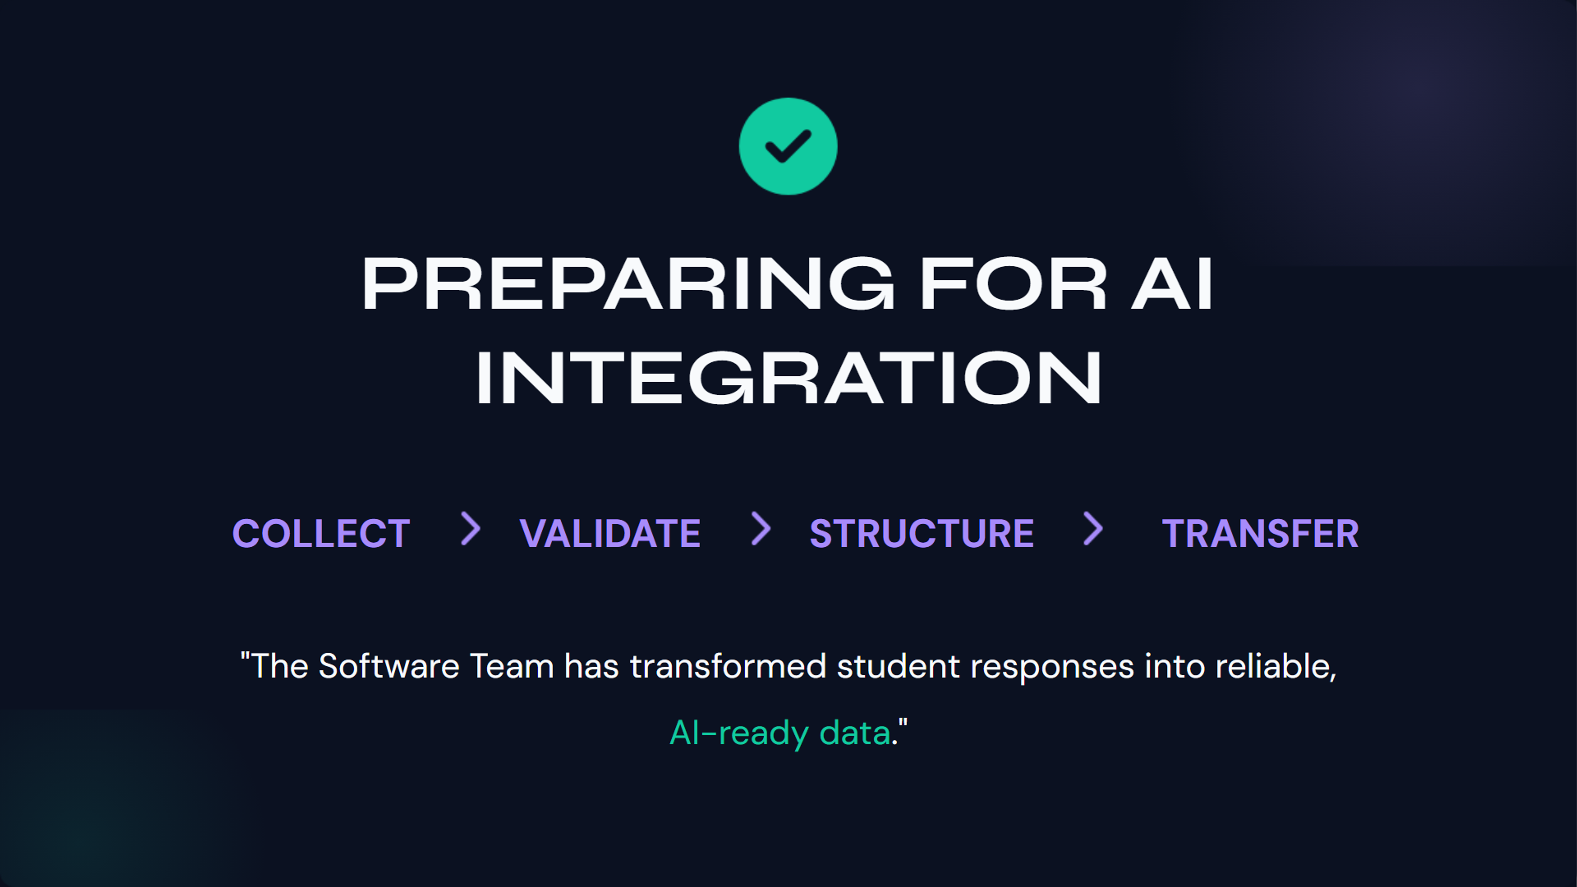
Notes:
"To summarize the software development lifecycle of Orient AI: our objective was to build the tracks upon which the AI train could run. We built a robust system to collect nuanced human input, aggressively validate it to protect the database, structure it mathematically, and seamlessly transfer it. The ultimate achievement of the software team was creating an environment that transforms subjective student anxiety and survey responses into reliable, structured, AI-ready data. The platform is built, the pipeline is secure, and the data is ready. Now, I will pass the floor to the Machine Learning team to explain what the AI does with that data."

Slide 21

MACHINE LEARNING MODEL DEVELOPMENT

Slide 22
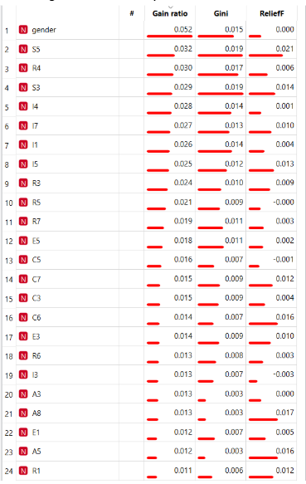
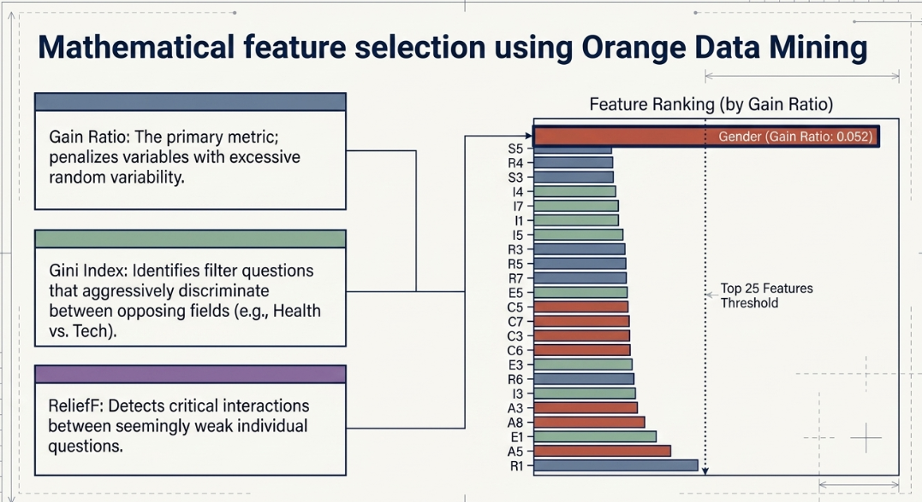
Questionnaires Generation Process
First Questionnaire: Optimization
Reference Dataset: Holland Code (RIASEC) from Open Psychometrics
Notes:
P2
Feature Selection Pipeline:
Thorough preprocessing and data cleaning
Filtering with Python (145k → 72k records)
Selection using Orange Rank Widget

Slide 23
Questionnaires Generation
Process
Second Questionnaire: Implementation
Main Objectives:
Mapping of the Existing Academic Offer in Łódź
Strategic Creation of Personalized Questions
Notes:
P2
DECIR Q SOLO ESTE PQ NO TENIAMOS DATA SUCFICIENTE, Y LO BUENO Q ES UN MODELO DEPENDE DE DATSET ENTRENAMIENTO, y admeas q no teniamos de donde sacar preguntas las generamos nosotros

Slide 24
Machine Learning Models Needed
We developed three separate machine learning models for the app. Each model focusing on a single target variable.
Model 1
Questionnaire 1
Target: area of study
Model 2
Questionnaire 1
Target: satisfaction
Model 3
Questionnaire 2
Target: career of choice
We need 3 models Selected on synthetic data
Notes:
P3

Slide 25
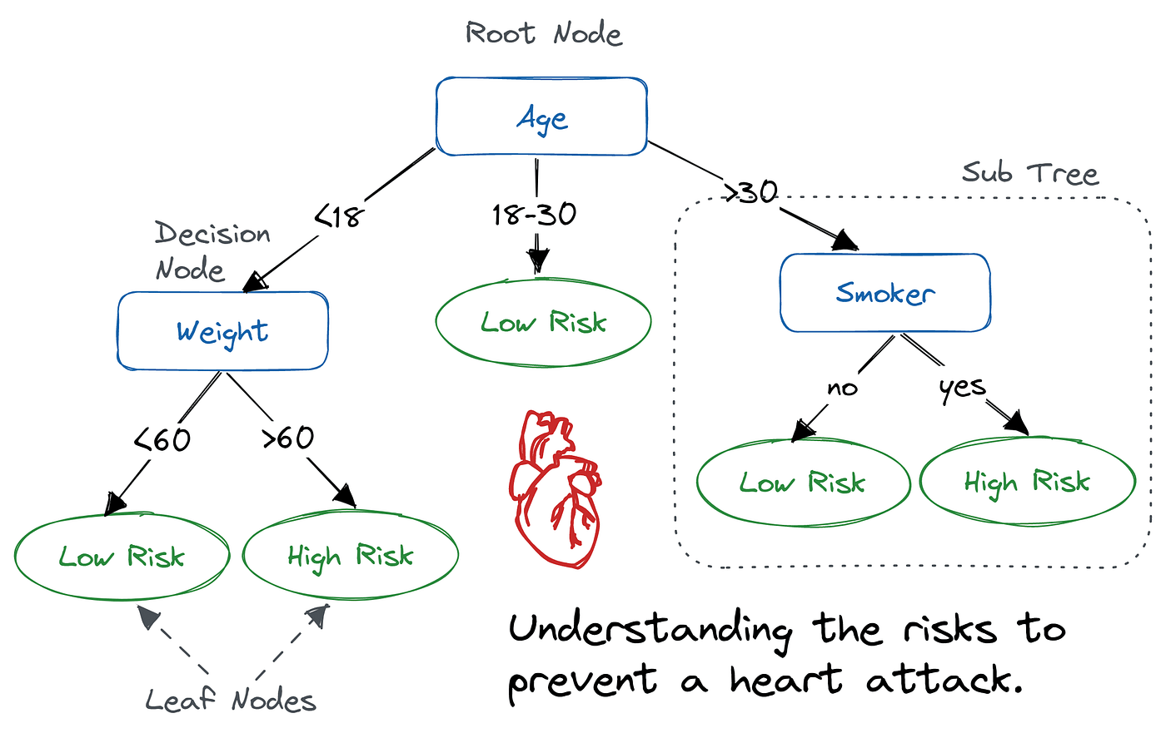
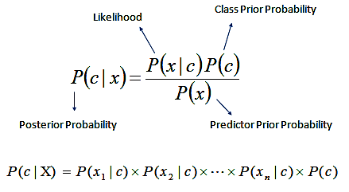
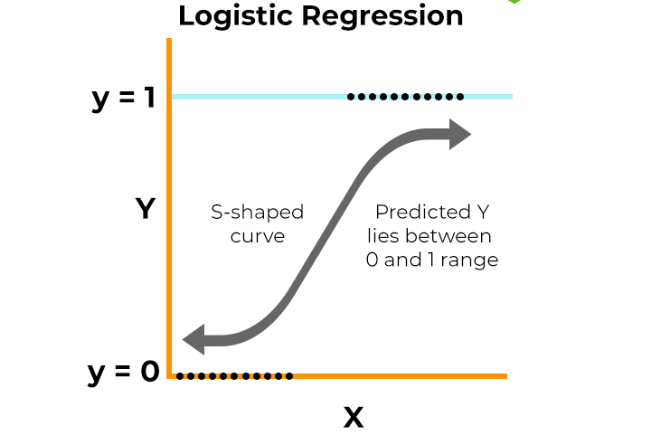
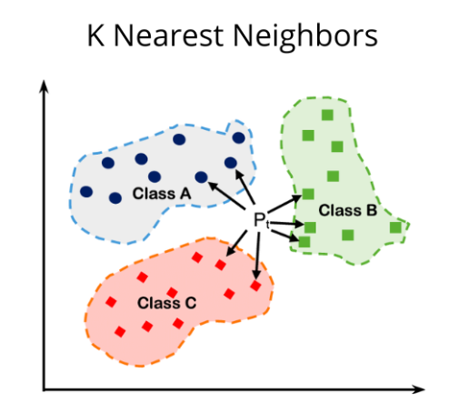
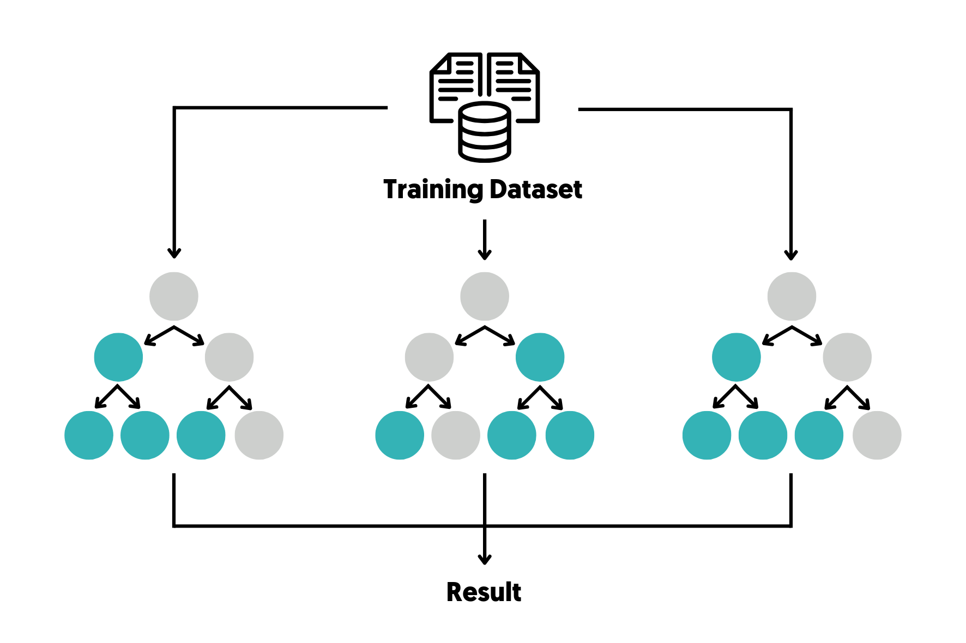
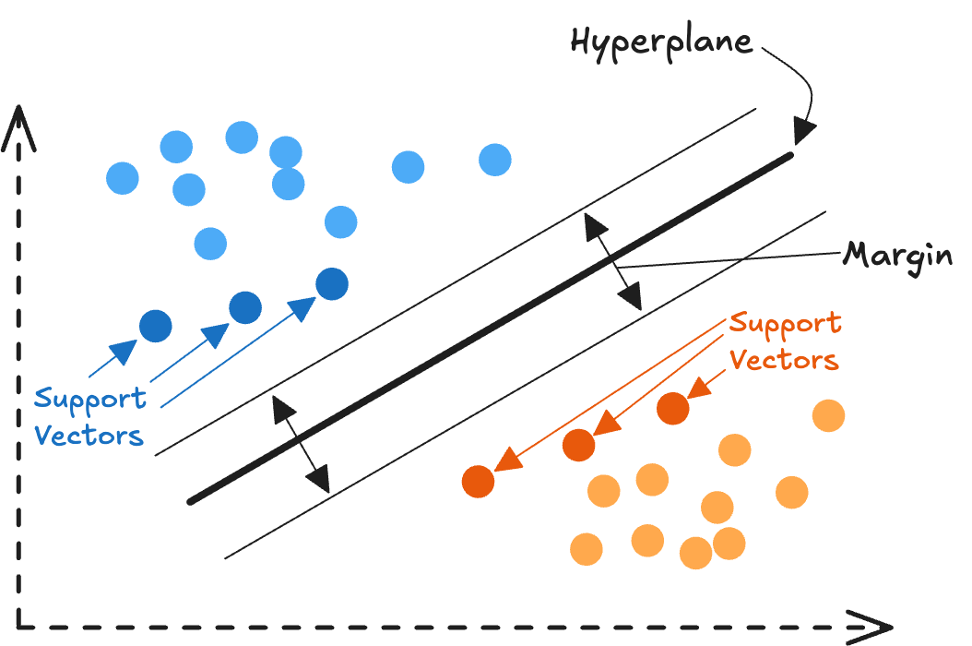
Explanation of the Tested Models
CLASSIFICATION
- Logistic Regression
- Naive Bayes
- Decision Tree
- KNN
- SVM
- Random Forest
Notes:
P3

Slide 26
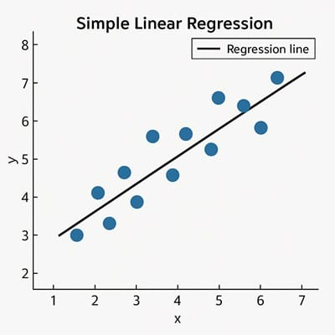
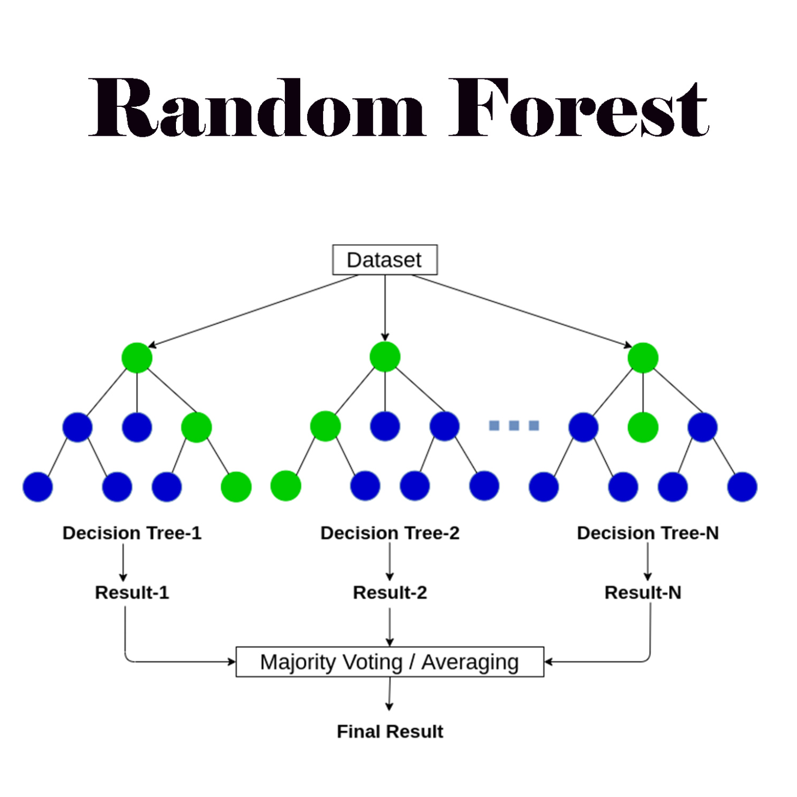
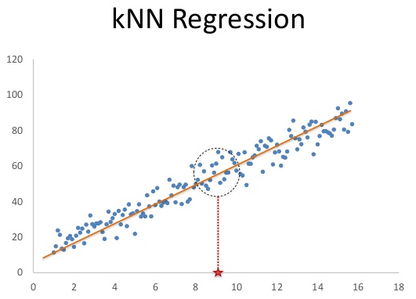
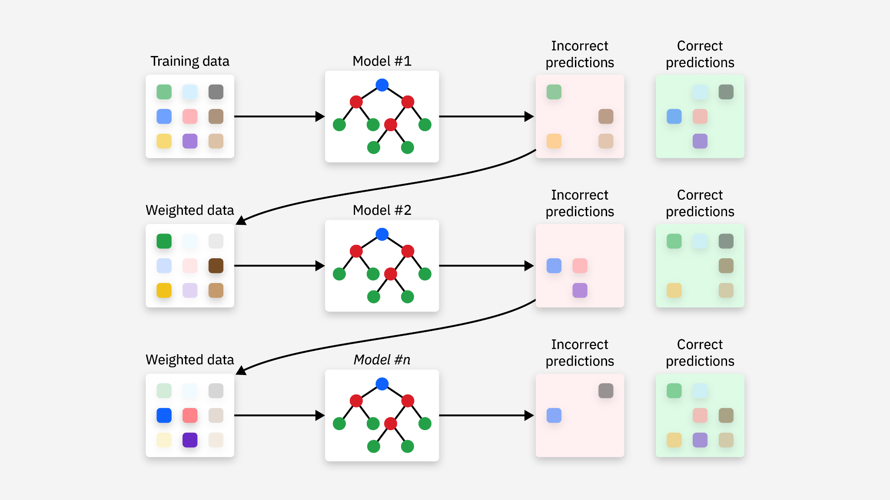

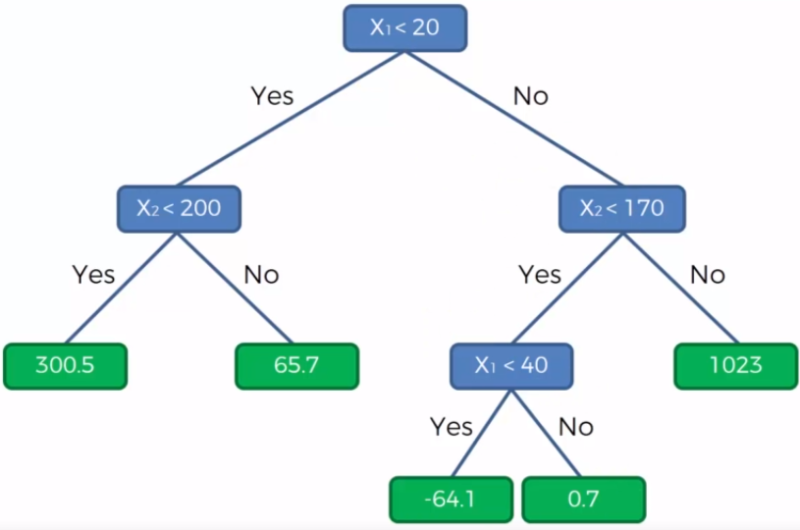
Explanation of the Tested Models
REGRESSION
- Linear Regression
- Random Forest Regressor
- Gradient Boosting
- Decision Tree Regressor
- KNN Regressor
- Neural Network
Notes:
P3

Slide 27
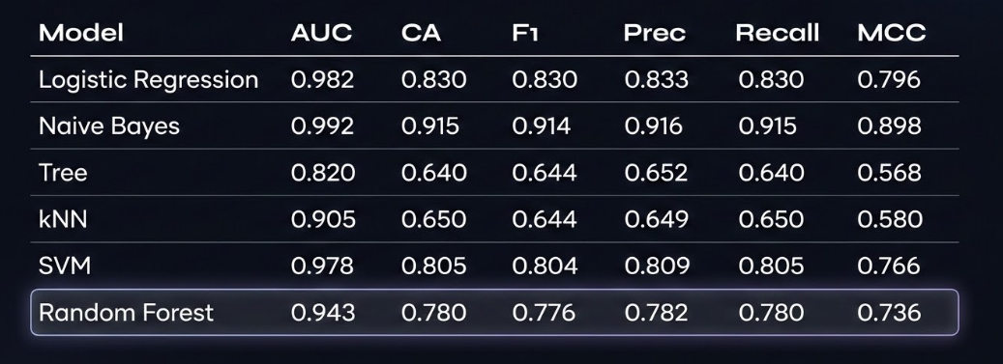
Model 1: Questionnaire 1 (target-area of study)
Notes:
P3
Models were trained on 72,000 refined records (Gold Dataset) using cross-validation. While Naive Bayes showed high raw metrics, Random Forest was selected due to complex non-linear feature handling.

Slide 28
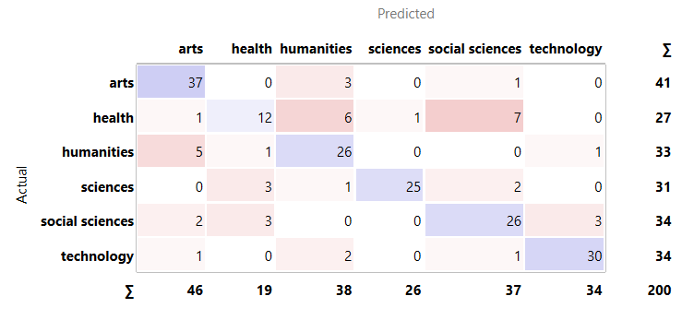
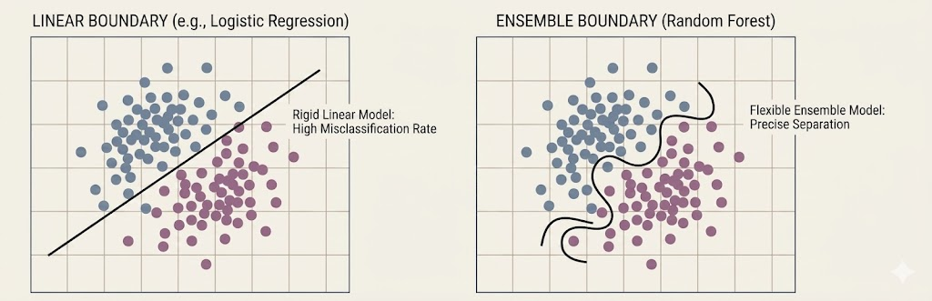
Why Random Forest?
Superior handling of overlapping academic fields
High resistance to overfitting compared to single Decision Trees
unmatched robustness without requiring tedious data preprocessing
makes no assumptions and is far more resilient to noisy data
Notes:
P3
Random Forest effectively manages the intricate and intermingled patterns present in the fields like STEM and Health, which often share underlying characteristics, without getting confused by the overlap.
2. By aggregating multiple decision trees, the ensemble method averages cut individual errors and idiosyncrasies, resulting in a model that generalizes better to new data and is less likely to memorize training noise.
3. The algorithm’s flexible architecture allows it to model complex, non-linear interactions and dependencies inherent in subjective survey data, which linear model struggle to capture accurately.

Slide 29
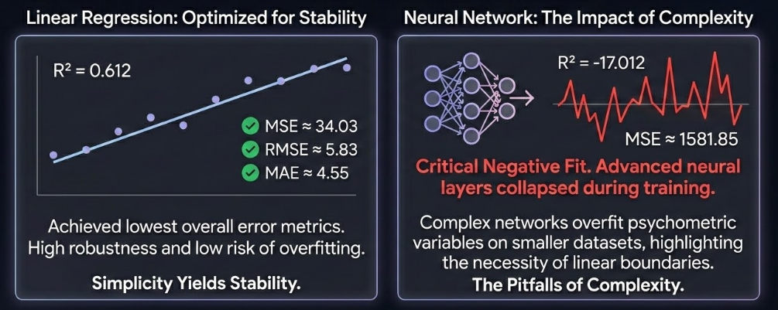
Model 2: Questionnaire 1
(target-satisfaction)
Notes:
P4

Slide 30
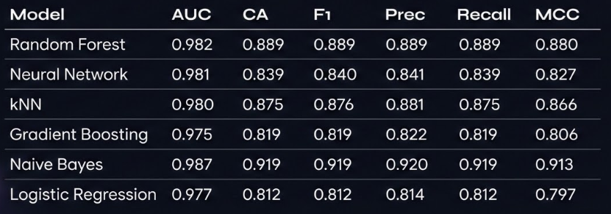
Model 3: Questionnaire 2
(target-degree)
Notes:
P4

Slide 31


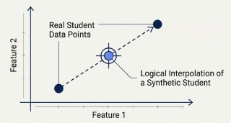
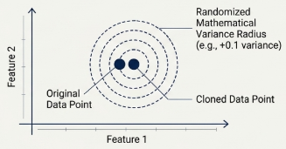
DATA AUGMENTATION
SMOTE Strategy
Gaussian Noise Injection
Synthetic Minority Over-sampling: Synthetic data is generated by interpolation between existing minority instances, filling the data space without memorization.
Small amounts of random Gaussian noise (±0.1 to ±0.2) are added to cloned minority samples to introduce variation and prevent overfitting.
Notes:
P4
Initial surveys returned 238 responses, creating massive technology-major bias. To train unbiased models, we used 2 strategies to draw virtual profiles between real data points.

Slide 32
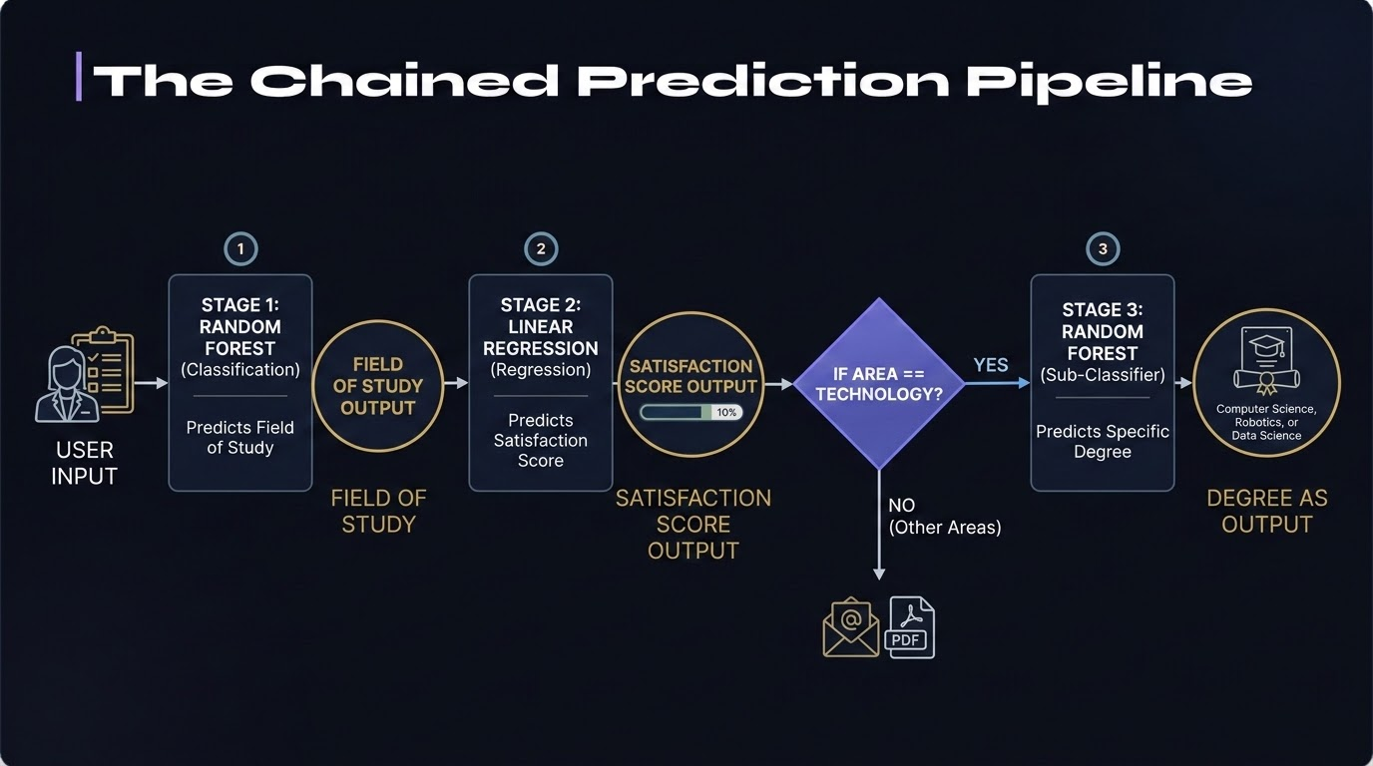
Notes:
P4

Slide 33
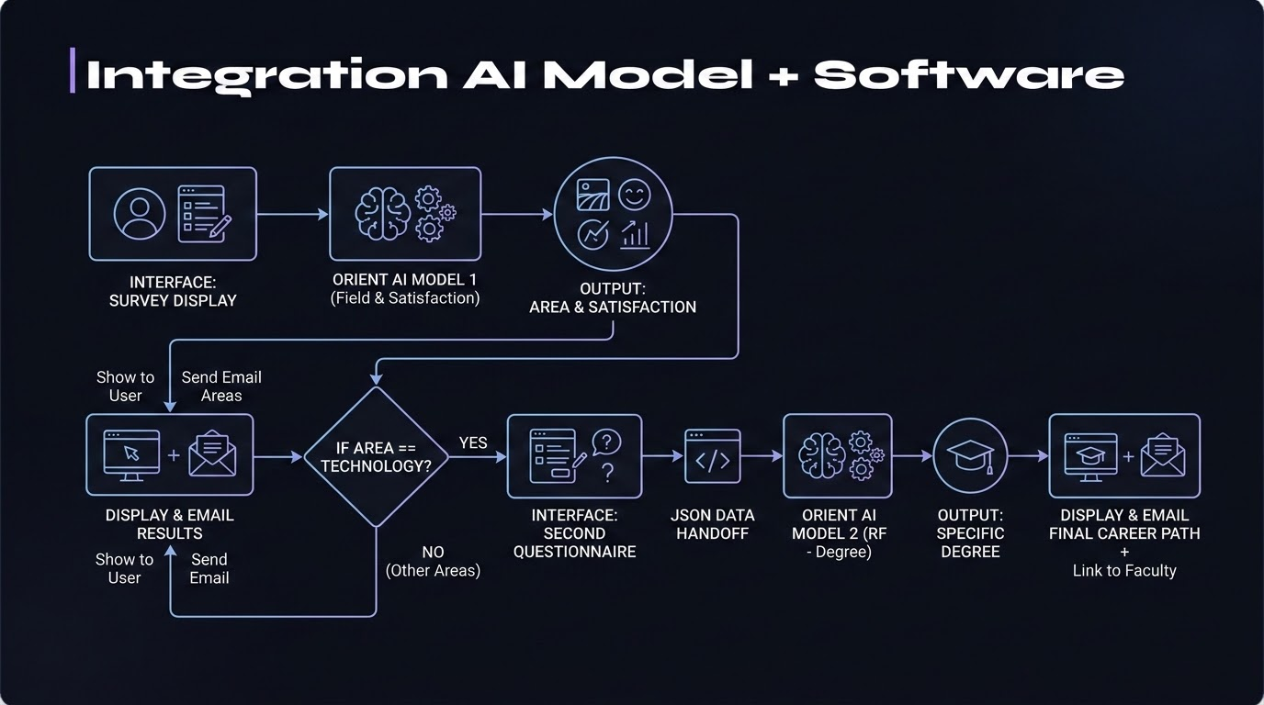
Notes:
P4

Slide 34

ORIENT AI
https://orientai-deployment.streamlit.app/

Slide 35
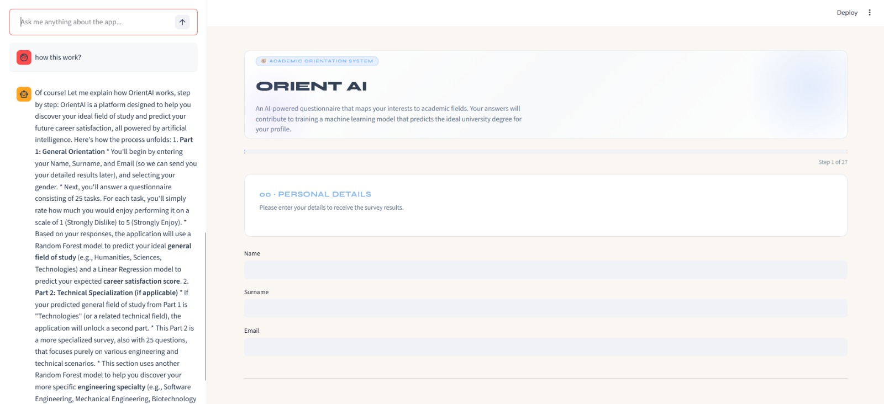

Slide 36
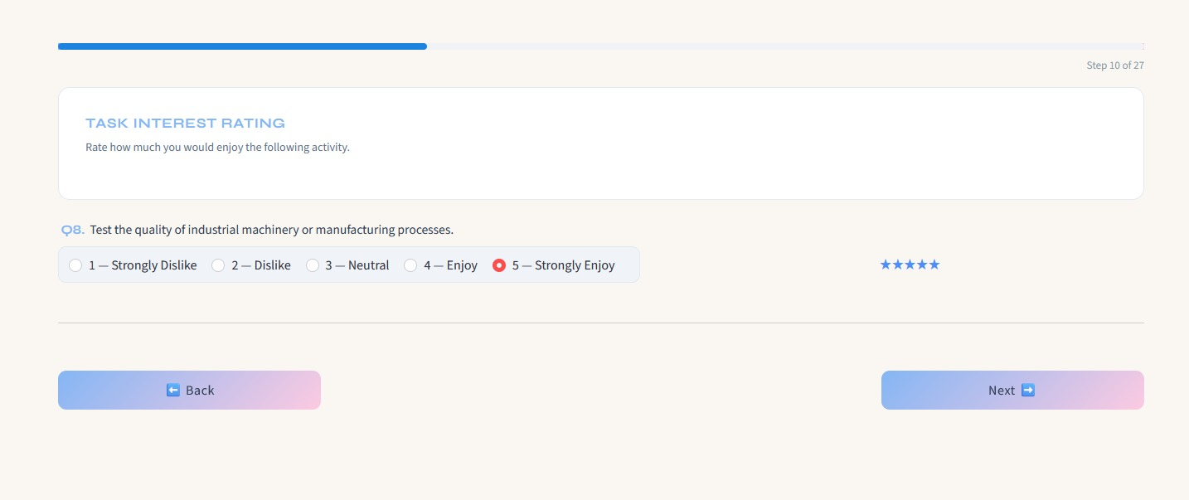

Slide 37
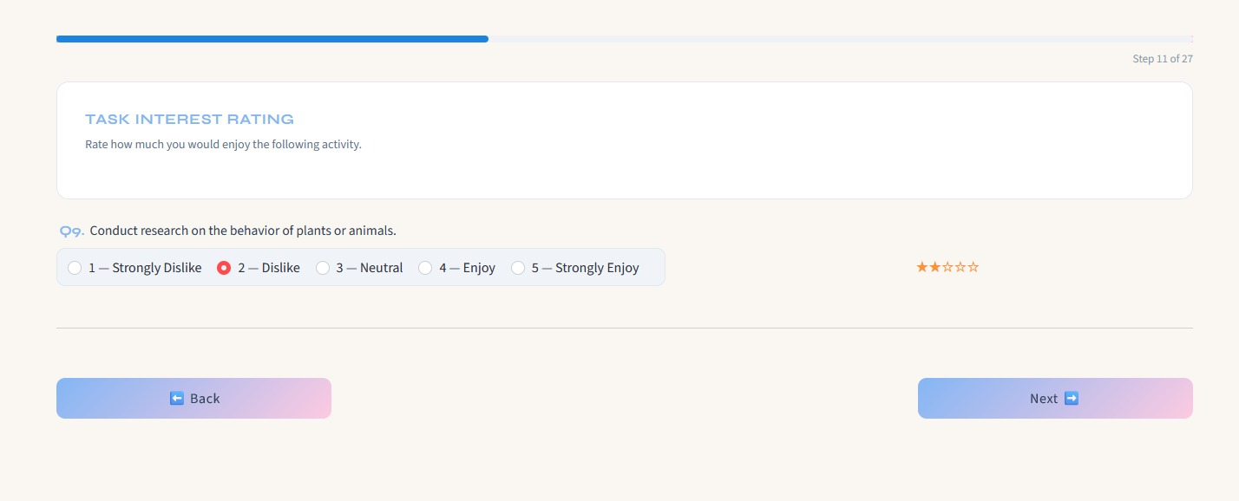

Slide 38
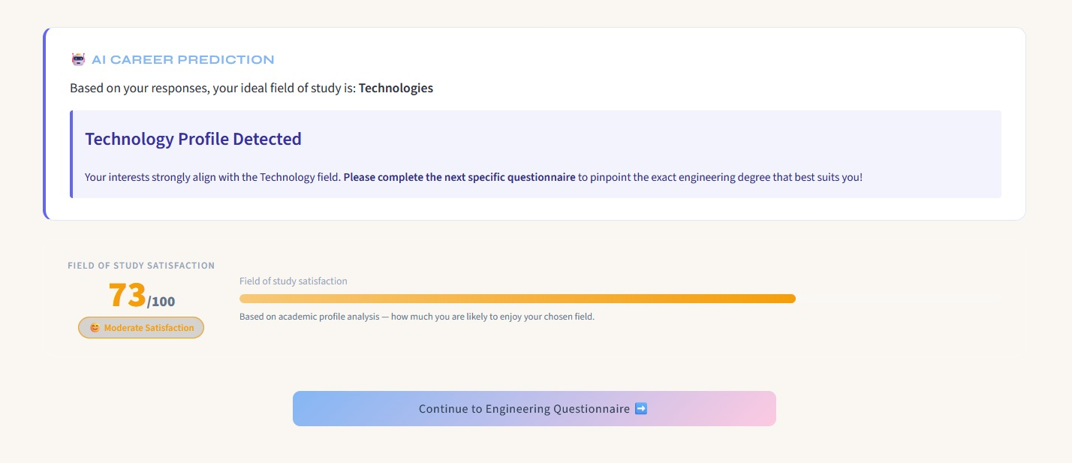

Slide 39
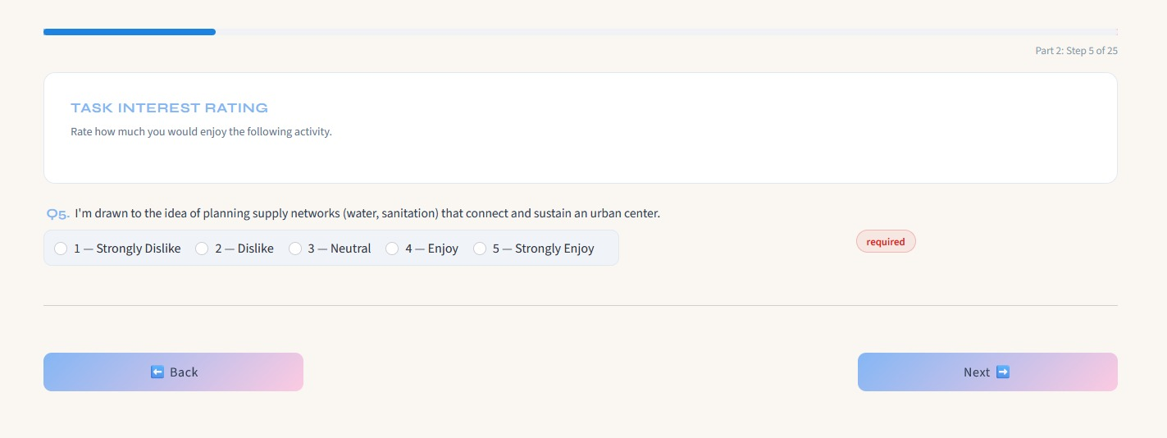

Slide 40
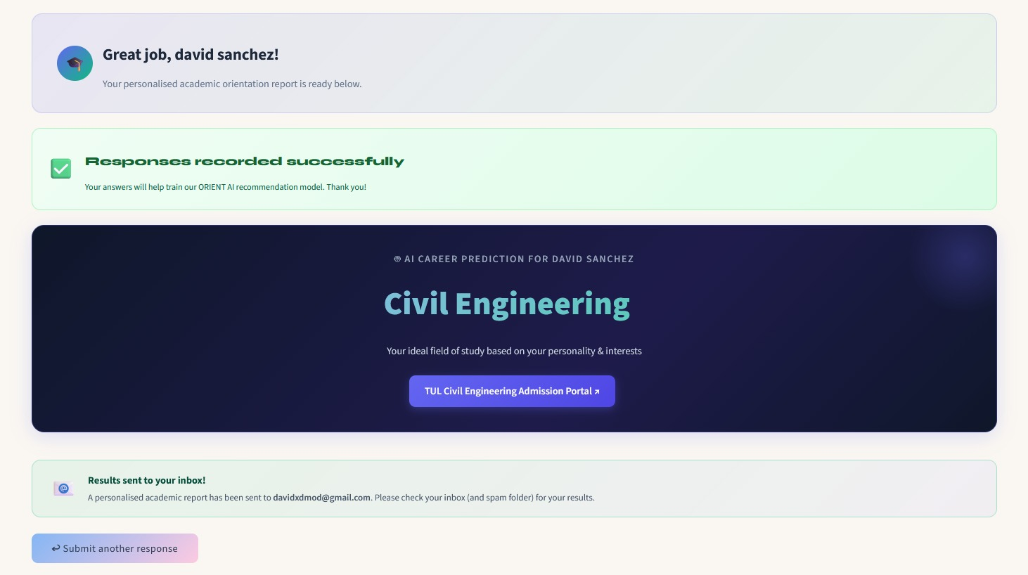

Slide 41
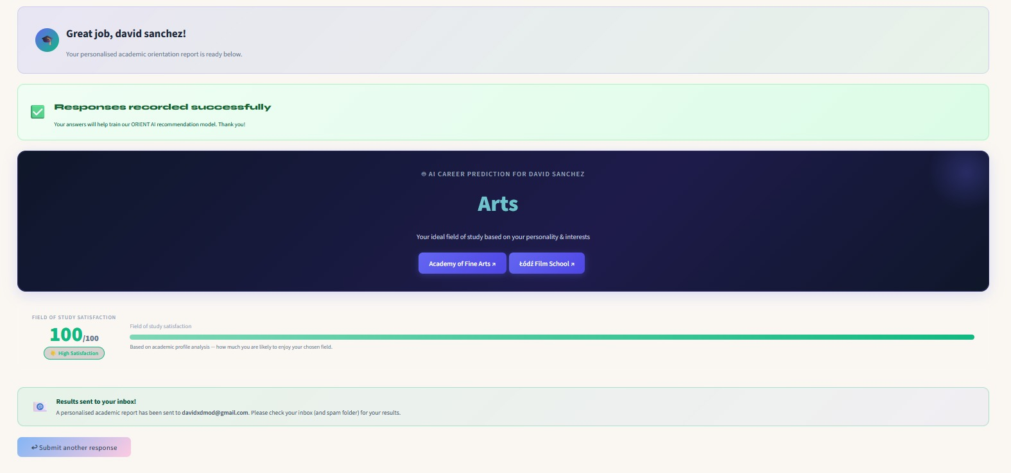

Slide 42
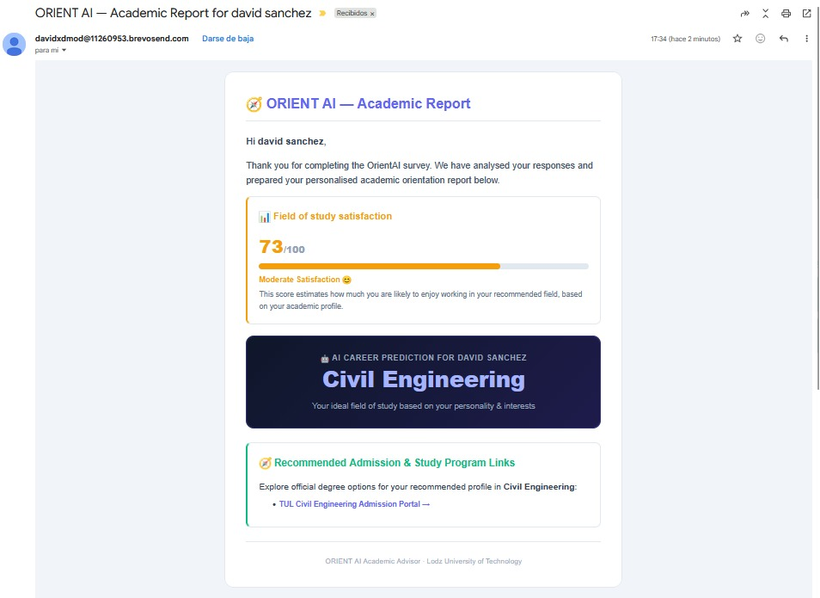

Slide 43
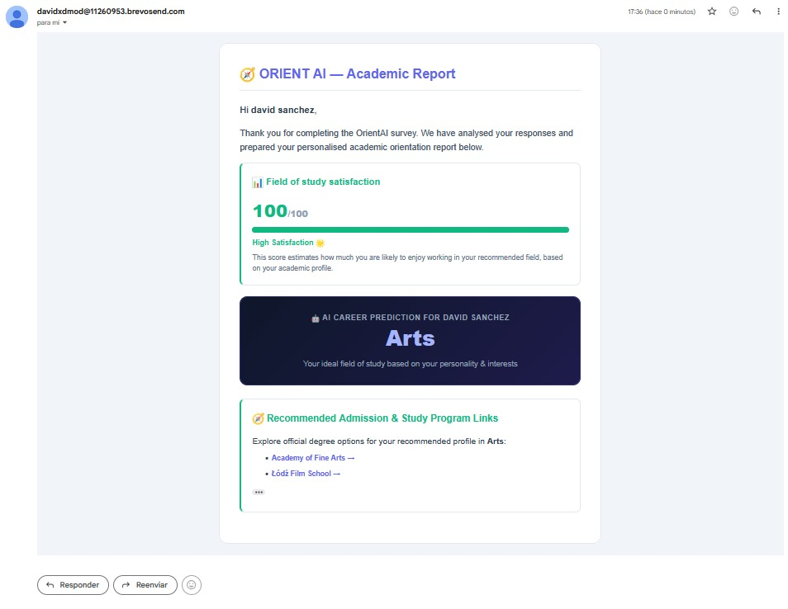

Slide 44



THE FUTURE OF ORIENT AI
Educational Centers Integration in high schools to guide students pre-selection.
Continuous Learning Re-training based on real-time feedback loops from graduates.
Global Scalability Deploying to AWS/Cloud to reach international markets.
Let's make academic selection objective, predictable, and reachable.
Notes:
P?

Slide 45

Questions & Answers
GET IN TOUCH!
Contact:
Aroa Aguiño Domínguez –> 905686@edu.p.lodz.pl
Maria Encina Díez del Río --> 905687@edu.p.lodz.pl
Mario Fernández Costello --> 905688@edu.p.lodz.pl
Naroa Genicio Iglesias --> 905689@edu.p.lodz.pl
David Sánchez Sánchez --> 905590@edu.p.lodz.pl
Jaime Esteban Reano --> 905805@edu.p.lodz.pl
Jorge Domínguez Palomo --> 905804@edu.p.lodz.pl

